Slide 1



Department of Employment Programs
Employment Promotion Services
2018

Slide 2
Labor market management information system worknet.gov.ge
In the system online can register
Job seeker
Employer
Vacant position
The following modules are also included in the system:
Automatize search of job seekers and vacancies, connectivity of applicants and employers, feedback data processing and analysis modules.

Slide 3
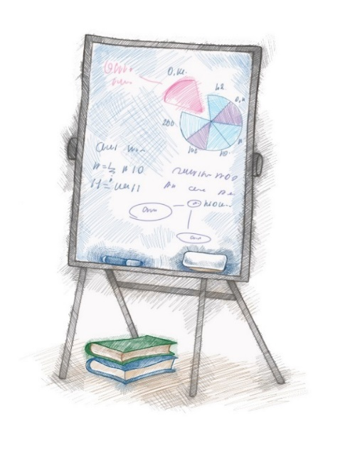
worknet.gov.ge
Totally registered job seeker - 161 611; among them active - 136 307;
We cooperate with about 900 employers, among them , on portal registered 432;
Vacancies presented in 2017 - 5711;
The vacancies presented in the I quarter quarter of 2018 - 2167;
According data By I quarter of 2018, 482 job seekers was employed; among them 42 Persons with Disabilities.

Slide 4
Services and Programs
Intermediary service;
Counseling - individual, group;
Career planning;
Supporting employment;
Subsidizing
Job fairs and mass interviews;
Labor market research;
Professional training and retraining;
Internship.

Slide 5
Intermediary service
Mediation between job seekers and employers;
In 2016, mediation services were provided to about 3200 job seekers. Among them, 265 were employed.
In 2017, mediated services were provided to about 2500 job seekers. Among them, employed 399.
In 2018 the average service was provided to 1032 job seekers. Among them 70 were employed.

Slide 6
Group counseling
Introduction of the rules of conduct of job seekers in the labor market and increase competitiveness. From 2014 up to now, more than 10,000 job seekers have been consulted in the country. between them:
Persons With Disability - 159, IDP - 686, probationer - 148
Professional career planning
Career Planning Services (Services)
The service is carried out in 8 territorial units since 2016. 725 job seekers consulted.

Slide 7
Promoting the employment of low-competitive, Vulnerable groups - Supported Consultants' Services
Supported services were provided in 2016-2017 – to 519 persons with disabilities
In 2018 –to 103 persons with disabilities
Subsidy component
Subsidizing employment means financing 50% of the salary payable by employers who are interested in promoting employment for young people (from 18 years to 29 years) and for persons with disabilities for vacant position presented by them with no more than 470 GEL.
According to the data of 2017, 23 employers and 53 disabled persons were involved in the subsidy program. 37 job seekers were employed
In the 2018 Subsidy program, according to I quarterly data 6 employers and 9 job seekers are involved.

Slide 8
Job fair
In 2014, 1 employment forum was held. In Tbilisi
In 2015 1 employment forum in Kutaisi and 1 employment week in Tbilisi and Kakheti.
In 2017 there were held 13 Employment Forums and 1 Employment Festival. Among them 4 forums for persons with disabilities.
One employment forum was held in the 1st quarter of 2018.
Mass Interviews
In the first quarter of 2018, 7 mass interviews were conducted in which 217 tickets were issued. Monitoring is under way.

Slide 9

Qualitative research of the labor market
Goal:
Identify the required professions, knowledge and skills in the labor market.
In March 2015, conducted a joint research with the company "BCG" and in 4th Quarter the Department conducted the research independently
In 2017, the qualitative research of the labor market was conducted by the Department of Employment Programs, with the support of EU employment and vocational education reforms Technical Assistance Project (EUVEGE).
Required professions identified as a result of research are based to
Professional training and retraining State program for upgrading qualification in 2018.

Slide 10

Professional training and retraining
In 2017 the state budget was allocated 2 014 000 for the implementation of the program;
The program was implemented in 2 stages and covered Tbilisi and 15 municipal units:
Within the framework of the program voucher was issued on 2360 job seekers;
The training course successfully completed 2130 job seekers;
In 2018, the state budget was allocated 2 090,000 for implementation of the program;
The program will be implemented in 2 stages, including Tbilisi and 17 municipal units:
51 Required Profession
44 professional vocational schools (in addition to 4 branches)
Among them: 27 private, 17 state;

Slide 11
Internship
The duration of the internship is determined from 1 to 3 months, in agreement with the employer;
Within the internship, the job seeker will be financed in the amount of 200 GEL per month (as a scholarship);
Within the framework of the 2017 Program:
The agreement has been signed with 26 organizations;
129 job seekers (including 37 with disability and 1 Person with special educational needs) involved in the internship program;
44 job seekers were employed, including 5 with disability.
According to the latest data in the 2018 program:
The contract was signed with 23 employers.
90 job seekers (including 20 disabled persons) are involved in the internship program. 2 job seekers are already employed.

Slide 12

Thank you for your attention!

